Slide 1
Design and Analysis of Algorithms
NP-Completeness(ch34)

Slide 2
Design and Analysis of Algorithms
NP-Completeness
Topics:
-- Computability
-- Analysis of Algorithms
-- NP-Completeness

Slide 3
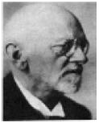
Computability
“Every mathematical problem can be solved. We are convinced of that. After all, one of the things that attracts us most when we apply ourselves to a mathematical problem is precisely that within us we always hear the call: here is the problem, search for the solution, you can find it by pure thought, for in mathematics there is no ignorabimus.”
Hilbert
Notes:
ignorabimus:we shall never know

Slide 4
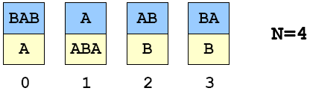
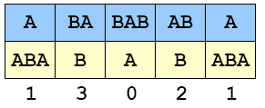
A Puzzle (“Post’s Correspondence Prob.”)
Given a set of cards:
-- N card types (can use as many of each type as possible)
-- Each card has a top string and bottom string.
Example 1:
Puzzle:
-- Is it possible to arrange cards so that top and bottom strings are the same?
Solution 1:

Slide 5
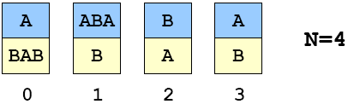
A Puzzle (“Post’s Correspondence Prob.”)
Given a set of cards:
-- N card types (can use as many of each type as possible)
-- Each card has a top string and bottom string.
Example 2:
Puzzle:
-- Is it possible to arrange cards so that top and bottom strings are the same?
Solution 2:
Notes:
波斯特对应问题

Slide 6
PC Problem Contest
Contest
  Additional restriction: string must start with ‘S’.
  Be the first to solve this puzzle!
    -extra credit for first correct solution
  Check solution by putting STRING ONLY (blanks and line breaks OK) in a file solution.txt, then type pcp < solution.txt
Hopeless challenge for the bored:
  Write a program that reads a set of Post cards, and determines
  Whether or not there is a solution.
Notes:
http://www.theory.informatik.uni-kassel.de/~stamer/pcp/pcpcontest_en.html

Slide 7
Overview
Formal language.
  Rigorously express computational problems.
  Ex: L = {2,3,5,7,11,13,17,…}.
Abstract machines recognize languages.
  Ex. Is 977 prime? Is 977 in L?
  Essence of computers.
  What is an “algorithm”?
  Is it possible, in principle, to write a program to solve any problem (recognize any language)?

Slide 8
Background
Abstract models of computation help us learn:
  Nature of machines needed to solve problems.
  Relationship between problems and machines.
  Intrinsic difficulty of problems.
As we make machines more powerful, we can recognize more languages.
  Are there languages that no machine can recognize?
  Are there limits on the power of machines that we can image?
Notes:
Intrinsic：固有的, 内在的, 本质的

Slide 9
Background
Pioneering work in the 1930’s.
(Princeton == center of universe)
  Turing, Church, von Neumann, Gödel. (inspiration from Hilbert)
  Automata, languages, computability, complexity, logic, rigorous definition of “algorithm.”
Notes:
Pinceton：普林斯顿

Slide 10
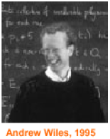
Undecidable Problems
Hilbert’s 10th Problem.
  “Devise a process according to which it can be determined finite number of operations whether a given multivariate polynomial has an integral root.”
    Example 1: f(x,y,z)=6x³yz²+3xy²-x³-10
    Example 2: f(x,y)=x²+y²-3
    Example 3: f(x,y,z)=x^{n}+y^{n}-z^{n}
Notes:
devise：设计
multivariate:多元的
polynomial：多项式

Slide 11
Undecidable Problems
Hilbert’s 10th Problem.
  “Devise a process according to which it can be determined finite number of operations whether a given multivariate polynomial has an integral root.”
  Problem resolved in very surprising way. (Matiyasevich, 1970)
  How can we assert such a mind-boggling statement?
Notes:
The impossibility of obtaining a general solution was proven by Yuri Matiyasevich in 1970
http://mathworld.wolfram.com/HilbertsProblems.html
resove：解答，not solve

Slide 12
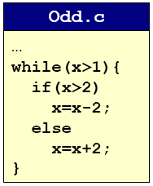
Undecidable Problems
Hilbert’s 10th Problem.
Post’s Correspondence Problem.
Halting Problem.
  Write a C program that reads in another program and its inputs, and decides whether or not it goes into an infinite loop.
    loop infinite often signifies a bug
  Program 1.
    8 6 4 2 4 2 4 2 4 2 4 2 4 2 4
    9 7 5 3 1

Slide 13
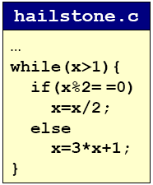
Undecidable Problems
Hilbert’s 10th Problem.
Post’s Correspondence Problem.
Halting Problem.
  Write a C program that reads in another program and its inputs, and decides whether or not it goes into an infinite loop.
    loop infinite often signifies a bug
  Program 2.
    8 4 2 1
    7 22 11 34 17 52 26 13 40
    20 10 5 16 8 4 2 1

Slide 14
Undecidable Problems
Hilbert’s 10th Problem.
Post’s Correspondence Problem.
Halting Problem.
Program Equivalence.
Optimal Data Compression.
Virus Identification.
Impossible to write C program to solve any of these problem!

Slide 15
Church-Turing Thesis
Church-Turing thesis (1936).
  Q. Which problems can a Turing machine solve?
  A. any problem that any real computer can solve.
“Thesis” and not a mathematical theorem.
Implications:
  Provides rigorous definition for algorithm.
  Universality among computational models.
  If a problem can be solved by TM, then it can be solved on EVERY general- purpose computer.
  If a problem can’t be solved by TM, then it can’t be solved on ANY physical computer.
Notes:
thesis：命题，not theorem

Slide 16

A More Powerful Computer
Post machine (PCP-286).
  Input: set of Post cards.
  Output.
    YES light if PCP is solvable for these cards.
    NO light if PCP has no solution.
PCP is strictly more powerful than:
  Turing machine.
  TOY machine.
  C programming language.
  iMac.
  Any conceivable super-computer.
Why doesn’t it violate Church-Turing thesis?
Notes:
conceivable：可能的, 想得到的, 可想像的

Slide 17
Halting Problems
Halting problem.
  Devise a TM that reads in another TM (encoded in binary) and its initial tape, and determine whether or not that TM would ever reach a yes or no state.
  Write a C program that reads in another program and its inputs, and decides whether or not it goes into an infinite loop.
Theorem (Alan Turing, 1937). Halting problem is undecidable.
  No TM can solve the halting problem. (not possible to write a C program either)
Proof intuition.
  Self-reference.
Notes:
paradox：悖论

Slide 18
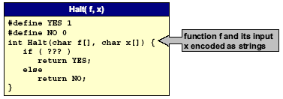
Halting Problem Proof
Assume the existence of Halt(f,x) that takes as input: any function f and its input x, and outputs yes if f(x) halts, and not otherwise.
  We prove Halt(f,x) can’t exist by contradiction.
  Note: Halt(f,x) always returns yes or no.
  (infinite loop not possible)

Slide 19
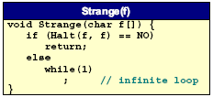
Halting Problem Proof
Assume the existence of Halt(f,x) that takes as input: any function f and its input x, and outputs yes if f(x) halts, and not otherwise.
  Construct program Strange(f) as follows:.
    calls Halt(f,f)
    halts if Halt(f,f) outputs no
    goes into infinite loop if Halt(f,f) outputs yes
  In other words:
    if f(f) does not halt then Strange(f) halts
    if f(f) halts then Strange(f) does not halt

Slide 20
Halting Problem Proof
Assume the existence of Halt(f,x) that takes as input: any function f and its input x, and outputs yes if f(x) halts, and not otherwise.
  Construct program Strange(f) as follows:.
    calls Halt(f,f)
    halts if Halt(f,f) outputs no
    goes into infinite loop if Halt(f,f) outputs yes
  In other words:
    if f(f) does not halt then Strange(f) halts
    if f(f) halts then Strange(f) does not halt
  Call Strange with ITSELF as input.
    if Strange(Strange) does not halt then Strange (Strange) halts
    if Strange(Strange) halts then Strange (Strange) does not halts
  Either way, a contradiction. Hence Halt(f,x) cannot exist.

Slide 21
Consequences
Halting problem is “not artificial.”
  Undecidable problem reduced to simplest form to simplify proof.
  Closely related to practical problems.
  Hilbert’s 10th problem, Post’s correspondence problem, program equivalence, optimal data compression
How to show new problem X is undecidable?
  Use fact that Halting problem is undecidable.
  Design algorithm to solve Halting problem, using (alleged) algorithm for X as a subroutine.
  Reduction
Notes:
alleged：所谓的

Slide 22
Implications
Practical:
  Work with limitations.
  Recognize and avoid unsolvable problems.
  Learn from structure.
    same theory tells us about efficiency of algorithms
Philosophical (caveat: ask a philosopher):
  We “assume” that any step-by-step reasoning will solve any technical or scientific problem.
  “Not quite” says the halting problem.
  Anything that is like (could be) a computer has the same flaw.
Notes:
caveat:警告

Slide 23
Summary
What is an algorithm?
  Informally: a step-by-step procedure for solving a problem.
  Formally: a Turing machine
Is it possible, in principle, to write a program to solve any problem?
  No.

Slide 24
Analysis of Algorithm
For many problems, there may be several competitive algorithms.
  Which one should I use?
Analysis of algorithms.
  framework for comparing algorithms and prediction performance.
  case study: sorting
Computational complexity.
  framework for studying intrinsic difficulty of problems.

Slide 25



Linear Growth
Grade school addition.
  Work is proportional to number of digits N.
  Linear growth: k N for some constant k.
Notes:
Majority operation:多数决定运算（操作数都是0或1，此处有三个操作数，只有当半数以上都是1时，结果才为1）

Slide 26
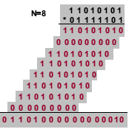
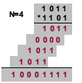

Quadratic Growth
Grade school multiplication.
  Work is proportional to square of number of digits N.
  Quadratic growth: k N² for some constant k.
Notes:
Quadratic:平方、二次方

Slide 27
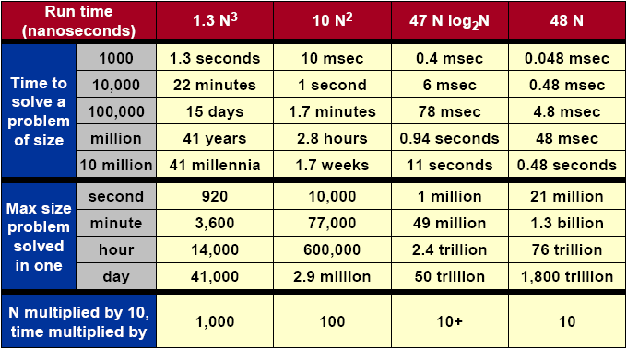
What Does It Matter?
Notes:
millennia:千年

Slide 28
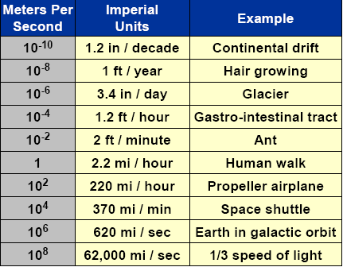
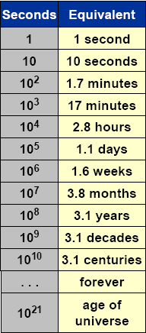

Orders of Magnitude

Slide 29
Historical Quest for Speed
Multiplication: a * b.
  Naïve: add a to itself b times. N2^{N} steps
  Grade school. N² Steps.
  Divide – and – conquer (Karatsuba, 1962). N^{1.58} steps
  Ingenuity (Schonhage and Strassen, 1971).
  N log N log log N steps
Greatest common divisor: gcd(a,b).
  Naïve: factor a and b, and find gcd(a,b). 2√N steps
  Euclid (20 BCE): gcd(a,b)= gcd(b, a mod b). lg N steps
Notes:
Ingenuity：独创性、机智
Euclid：欧几里得

Slide 30
Better Machines vs. Better Algorithms
New machine.
  Costs $$$ or more.
  Makes “everything” finish sooner.
  Incremental quantitative improvements (Moore’s Law).
  May not help much with some problems.
New algorithm.
  Costs $ or less.
  Dramatic qualitative improvements possible! (million time faster)
  May make the difference, allowing specific problem to be solved.
  May not help much with some problems.

Slide 31
Impact of Better Algorithms
Example 1: N-body-simulation.
  Simulate gravitational interactions among N bodies.
    physicists want N = # atoms in universe
  Brute force method: N² steps.
  Appel (1981). Nlog N steps, enables new research.
Notes:
gravitational：引力的、重力的

Slide 32
Impact of Better Algorithms
Example 2: Discrete Fourier Transform (DFT).
  Breaks down waveforms (sound) into periodic components.
    foundation of signal processing
    CD players, JPEG, analyzing astronomical data, etc.
  Grade school method: N² steps.
  Runge-Konig (1924), Cooley-Tukey (1965).
  FFT algorithm: N log N steps, enables new technology.
Notes:
astronomical：天文学的、天文的

Slide 33
Implementation of Algorithms
Algorithm.
  “Step-by-step recipe” used to solve a problem.
  Generally independent of programming language or machine on which it is to be executed.
Design.
  Find a method to solve the problem.
Analysis.
  Evaluate its effectiveness and predict theoretical performance.
Implementation.
  Write actual code and test your theory.
Notes:
方法，烹饪法

Slide 34
Computational Complexity
Framework to study efficiency of algorithms.
  UPPER BOUND = algorithm to solve the problem (worst- case).
  LOWER BOUND = proof that no algorithm can do better.
  OPTIMAL ALGORITHM: lower bound ~ upper bound.
Example 1: sorting.
  Measure costs in terms of comparisons.
  Upper bound = N log₂N (mergesort)
    quicksort usually faster, but mergesort never slow
  Lower bound = N log₂N - Nlog₂e.
    applies to any comparison – based algorithm
    proof.
  Optimal algorithm = mergesort

Slide 35
Computational Complexity
Framework to study efficiency of algorithms.
  UPPER BOUND = algorithm to solve the problem (worst- case).
  LOWER BOUND = proof that no algorithm can do better.
  OPTIMAL ALGORITHM: lower bound ~ upper bound.
Example 2: TSP.
  Upper bound = N! (2^{N} also possible).
  Lower bound = N
  Optimal algorithm = ask again in 50 years.
Essence of computational complexity.
  Closing the gap.

Slide 36
NP-Completeness
What is an algorithm?
  Turing machine
Which problems can be solved on a computer?
  not the halting problem
Which algorithms will be useful in practice?
  analysis of algorithms
Which problems can be solved in practice?
  probably not TSP

Slide 37
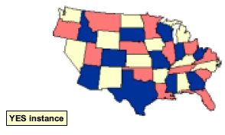
Some Hard Problems
3-COLOR: Given a planar map, can it be colored using 3 colors so that no adjacent regions have the same color?

Slide 38
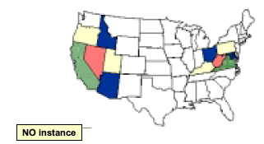
Some Hard Problems
3-COLOR: Given a planar map, can it be colored using 3 colors so that no adjacent regions have the same color?

Slide 39
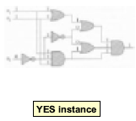
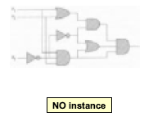
Some Hard Problems
CIRCUIT-SAT: Is there a way to assign inputs to a given Boolean (combinational) circuit that makes it true?

Slide 40
Some Hard Problems
FACTOR: Given two positive integers x and U, is there a nontrivial factor of x that is less than U?
  Factoring is at the heart of RSA encryption.
Example 1: x = 23,536,481,273, U = 110,000
  YES: x = 104,729 * 224,737.
Example 2: x = 23,536,481,273, U = 100,000
  NO: 104,729 * 224,737 is prime factorization of x.
Example 3: x = 23,536,481,277, U = 23,536,481,277.
  NO: x is prime.
Notes:
RSA：R.Rivest,A.Shamir,L.Adleman，提出的一种利用指数运算的密码。

Slide 41

Some Hard Problems
TSP: A traveling salesperson needs to visit N cities. Is there a route of length at most D?

Slide 42
More Hard Problems
More hard computational problems.
  Biology: protein folding.
  Chemistry: chemical synthesis.
  Civil engineering: equilibrium of urban traffic flow.
  Finance: find minimum risk portfolio of given return.
  Electrical engineering: VLSI layout.
  Medicine: reconstructing 3 – D shape from biplane angiocardiogram.
  Operations research: optimal resource allocation.
  Physics: anti-ferromagnetic Potts model.
  Politics: Shapley-Shubik voting power.
  Pop culture: Minesweeper consistency.
  Statistics: optimal experimental design.
Notes:
synthesis：合成（in Chemical），综合
equilibrium：平衡、均衡
minimum risk portfolio：极小风险股份单
biplane:angiocardiogram：心血管X线照片
Operations research：运筹学
anti-ferromagnetic Potts model：反减Potts模型
pop culture:大众文化、通俗文化、商业性文化

Slide 43
Properties of Algorithms
A given problem can be solved by many different algorithms (TMs).
  Which ones are useful in practice?
A working definition: (Jack Edmonds, 1962)
  Efficient: polynomial time for ALL inputs.
    mergesort requires Nlog²N steps
  Inefficient: “exponential time” for SOME inputs.
    brute force TSP takes N! > 2^{N} steps.
Broad and robust definition has led to explosion of useful algorithms for wide spectrum of problems.

Slide 44
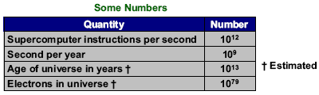
Exponential Growth
Exponential growth dwarfs technological change.
  Suppose each electron in the universe had power of today’s supercomputers …
  And each works for the life of the universe in an effort to solve TSP problem via brute force N! algorithm.
  Will not succeed for 1,000 city TSP!
    1000! >> 10¹⁰⁰⁰ >> 10⁷⁹ * 10¹³ * 10⁹ * 10¹²
Notes:
drawf:使矮小，相形见绌

Slide 45
Exponential Growth
“Every year since 1950, the number of American children gunned down has doubled.”
  Sociology thesis proposal in 2000.
What do YOU think?
  2⁵⁰ = 1,125,899,906,842,624
  Joel Best: worst ever social statistic.
    in Damned lies and statistics: untangling numbers from the media, politicians, and activists.
  Thesis cites 1994 Yearbook of the Children’s Defense Fund.

Slide 46
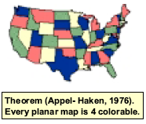
Properties of Problems
Which PROBLEMS will we be able to solve in practice?
  Those with efficient (polynomial-time) algorithms.
How can I tell if I am trying to solve such a problem?
  2-COLOR: yes
  3-COLOR: probably no
  4-COLOR: yes
  No easy answer! Theory of “NP-completeness” helps.

Slide 47
P
Definition of P:
  Set of all decision problems solvable in polynomial time on a deterministic Turing machine.
MULTIPLE: Is the integer y a multiple of x?
  YES: (x,y) = (17,51)
  NO: (x,y) = (17,50)
RELPRIME: Are the integers x and y relatively prime?
  YES: (x,y) = (34,39)
  NO: (x,y) = (34,51)
Definition important because of Strong Church-Turing thesis.
Notes:
relatively prime：互质数

Slide 48
Strong Church – Turing Thesis
Strong Church-Turing thesis:
  P is the set of all decision problems solvable in polynomial time on REAL computers.
Evidence supporting thesis:
  True for all physical computers.
    can create deterministic TM that EFFICIENTLY simulates any existing digital computer.
Possible exception
  Quantum computers – no conventional gates.

Slide 49
NP
EXP: set of decision problems solvable in exponential time on a deterministic Turing machine.
NP: does NOT mean “not polynomial.”
NP: set of all decision problems with efficient certification algorithm.
  Efficient: polynomial number of steps on deterministic TM.
  Certifier: check whether a proposed “solution” is correct.
    proposed solution is called CERTIFICATE (a hint)
    technical condition: certificate must be of polynomial-size

Slide 50
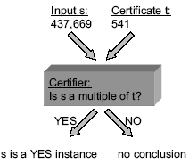
Certifies and Certificates
COMPOSITE: Given integer s, is s composite?
Observation. s is composite ←→ there exists an integer 1 < t < s such that s is a multiple of t.
  YES instance: s = 437,669
    certificate t = 541 or 809 (a factor)

Slide 51
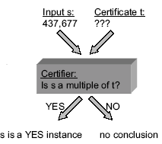
Certifies and Certificates
COMPOSITE: Given integer s, is s composite?
Observation. s is composite ←→ there exists an integer 1 < t < s such that s is a multiple of t.
  YES instance: s = 437,669
    certificate t = 541 or 809 (a factor)
  NO instance: s = 437,677
    no certificate can fool verifier saying YES
  Conclusion: COMPOSITE ∈ NP

Slide 52
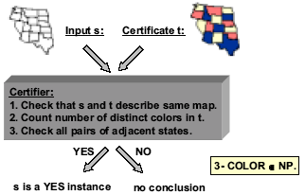
Certifies and Certificates
3-COLOR: Given planar map, can it be colored with 3 colors?

Slide 53

Alternate Definition of NP
NP: set of decision problems with efficient certification algorithms.
NP: set of decision problems solvable in polynomial time on a NONDETERMINISTIC Turing machine.
  Equivalent definition.
  Intuition: nondeterministic TM can guess and check all possible solutions in parallel.
  Real computer can simulate nondeterministic TM, but takes exponential time unless you get “lucky.”
P NP EXP

Slide 54

The Main Question
Does P = NP? (Edmonds, 1962)
  Is the original DECISION problem as easy as CERTIFICATION?
  Does nondeterminism help you solve problems faster?
Most important open problem in computer science.
  If yes, staggering practical significance.
  Clay Foundation Millennium $1 million prize.
Notes:
staggering:令人吃惊的

Slide 55
The Main Question
Does P = NP?
  Is the original DECISION problem as easy as CERTIFICATION?
If yes, then:
  Efficient algorithms for 3-COLOR, TSP, FACTOR.
  Cryptography is theoretically impossible (except for one-time pads) on conventional machines.
  Modern banking system will collapse.
  Harmonial bliss.
If no, then:
  Can’t hope to write efficient algorithm for TSP.
    see NP-completeness

Slide 56
The Main Question
Does P = NP?
  Is the original DECISION problem as easy as CERTIFICATION?
Probably no, since:
  Thousands of researchers have spent four decades in search of polynomial algorithms for many fundamental NP problems without success.
  Consensus opinion: P ≠ NP
But maybe yes, since:
  No success in proving P ≠ NP either.
Notes:
consensus

Slide 57
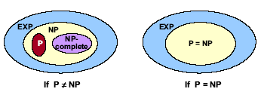
Implications of Universal Turing Machine
Definition of NP-complete:
  A problem in NP with the property that if it can be solved efficiently, then it can be used as a subroutine to solve any other problem in NP efficiently.
  “Hardest computational problems” in NP.

Slide 58
NP-Complete
Links together a huge and diverse number of fundamental problems:
  TSP, 3-COLOR, CIRCUIT-SAT, thousands more.
  Given an efficient algorithm for 3-COLOR, can efficiently solve TSP, CIRCUIT-SAT, FACTOR, etc.
  Can implement any program in 3-COLOR.
Note: FACTOR not know to be NP-complete.
Notorious complexity class.
  Only exponential algorithms known for these problems.
  Called intractable - unlikely that they can be solved given limited computing resources.
Notes:
Notorious:臭名昭著的

Slide 59
Reduction
Reduction is a general technique for showing that one problem is harder (easier) than another.
  For problems Y and X, we can often show: if Y can be solved efficiently, then so can X.
  In this case, we say X reduces to Y. (X is “easier” than Y).
Warmup: PRIMALITY reduces to FACTOR
  Given an efficient algorithm for FACTOR(x, U), want to design an efficient algorithm for PRIMALITY(p).
    Step 1: Compute FACTOR(p,p);
    Step 2: If answer = YES, return NO; otherwise return YES.
  Original problems: Is p = 437,669 prime?

Slide 60
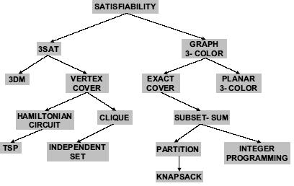
Reduction

Slide 61
The World’s First NP-Complete Problem
SAT is NP-complete. (Cook –Levin, 1960s)
Idea of proof:
  Given problem X ∈ NP, by definition there exists nondeterministic TM that solves X in polynomial time.
  Use Boolean variables to model which symbol occupies cell i at step t, location of read head at step t, state of finite control at step t, etc.
  Use logic gates to ensure machine makes legal moves, etc.
  SAT instance is satisfiable if and only if TM outputs Yes.

Slide 62
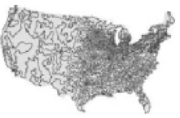
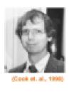
Coping with NP-Completeness
Hope that worst case doesn’t occur:
  Complexity theory deals with worst case behavior. The instance(s) you want to solve may be “easy”.
  TSP where all points are on a line or circle.
  13,059 US city TSP solved.

Slide 63
Coping with NP-Completeness
Hope that worst case doesn’t occur.
Change the problem.
  Develop a heuristic, and hope it produces a good solution.
    TSP assignment.
    Metropolis algorithm, simulating annealing, genetic algorithms
  Design an approximation algorithm: algorithm that is guaranteed to find a high-quantity solution in polynomial time.
    active area of research, but not always possible!
    Euclidean TSP tour within 1% of optimal.
Notes:
heuristic:试探的、启发式的
Metropolis:首要城市、都市， Metropolis algorithm（Monte Carlo Method）:随机算法
anneal：退火，有退火算法一说
genetic：遗传

Slide 64
Coping with NP-Completeness
Hope that worst case doesn’t occur.
Change the problem.
Exploit intractability.
Keep trying to prove P = NP.

Slide 65
Coping with NP-Completeness
A person can be at most two of the following three things:
  Honest.
  Intelligent.
  A politician.
If a problem is NP-complete, you can design an algorithm to do at most two of the following three things:
  Solve the problem to optimality.
  Solve the problem in polynomial time.
  Solve arbitrary instances of the problem.

Slide 66
Summary
Many fundamental problems are NP-complete
  TSP, 3-COLOR, CIRCUIT-SAT
Theory says we probably won’t be able to design efficient algorithms for NP-complete problems.
  You will surely run into these problems in your scientific life.
  If you know about NP-completeness, you can identify them and avoid wasting time and energy.

